Slide 1
MIS 6356.002
Business Analytics with R
Presentation
on
Churn Prediction for Telecom Sector
Under the guidance of
Prof. Jianqing Chen

Slide 2
Group : 8
Team Members
Amritesh Koul
Guru Charan
Jinal Panchal
Karan Malviya
Sagar Gupta

Slide 3


Problem Statement
In any company of any industry one of the major challenges company faces is losing their customers. Many marketing strategies is made to attract new customers, but the churning rate is still there. Thus, we choose this topic for our project where we address this situation by analyzing the type of users which are likely to break bond with the company
Churn Rate

Slide 4
Goal
Our goal is to analyze the dataset of Telco company and predict which type of customers are likely to leave, based on which retention strategy can be made and lower the churn rate
RETENTION RATE
CHURN RATE

Slide 5
Data Source
Telco System from Kaggle.
Data Description
Total Records | 7043
Total Variables | 21
Numerical Variable | 4
Categorical Variable | 17

Slide 7
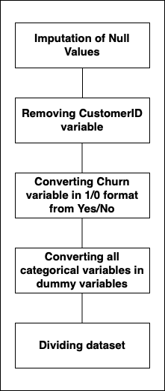
Data Cleaning and Processing :

Slide 8
Dummy variables
library(fastDummies)
original.df <- dummy_cols(original.df, select_columns = c('gender', 'Partner', 'Dependents', 'PhoneService', 'MultipleLines', 'InternetService', 'OnlineSecurity', 'OnlineBackup', 'DeviceProtection', 'TechSupport', 'StreamingTV', 'StreamingMovies', 'Contract', 'PaperlessBilling', 'PaymentMethod’))
original.df <- original.df[,-c(1,3,4,6,7,8,9,10,11,12,13,14,15,16,17)]

Slide 9
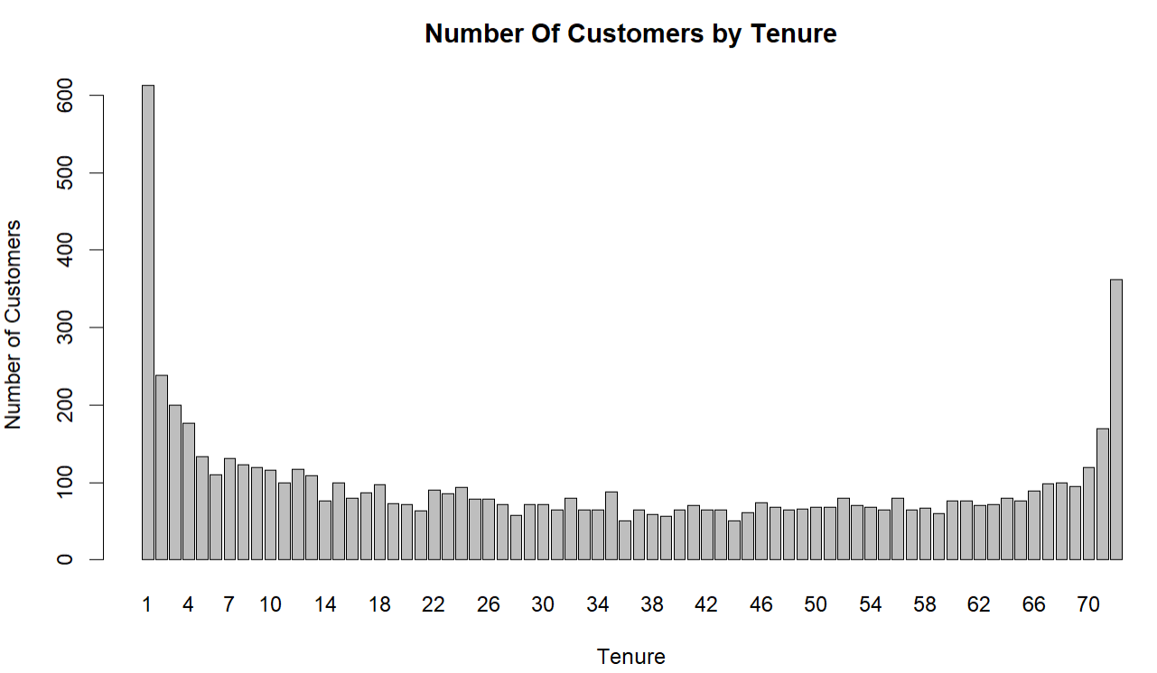
Significant Variables in the Data Set
Number of Customers vs. Tenure

Slide 10
Significant Variables in the Data Set
Ratio of senior citizen among all customers

Slide 11
Decision Tree :

Slide 12
Decision Tree :

Slide 13
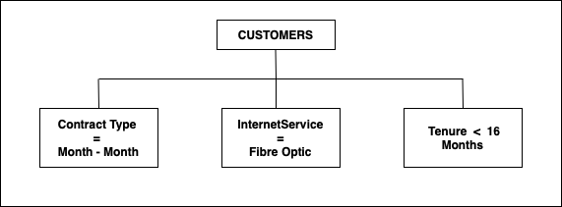
Decision Tree Conclusion :

Slide 14
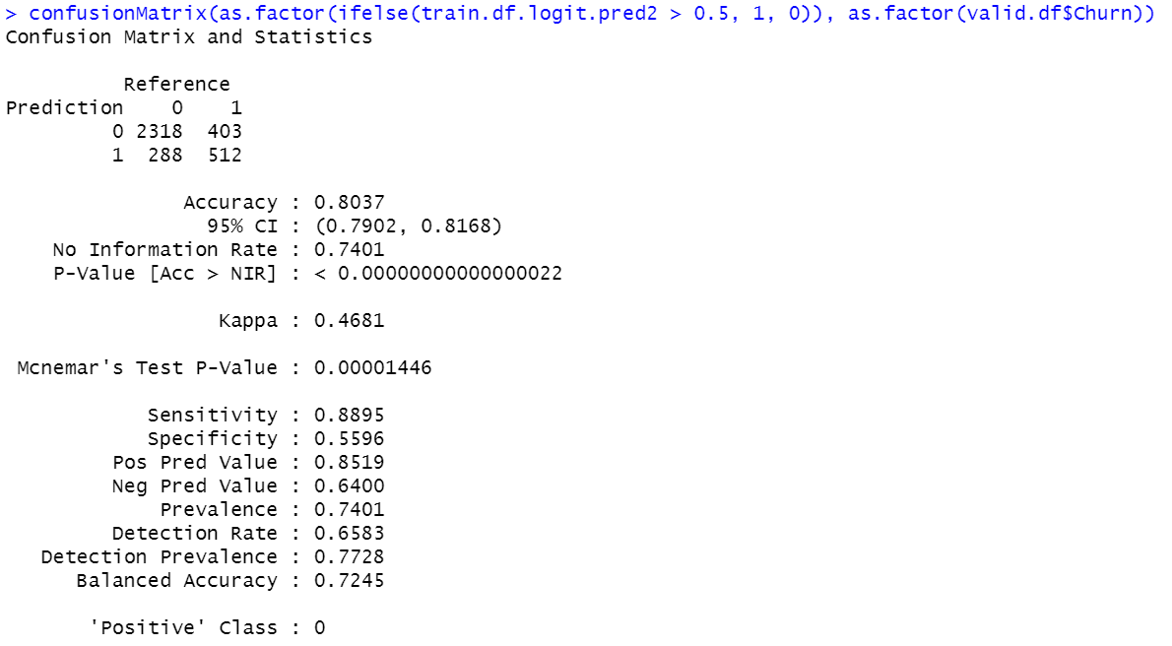
Logistic Regression Model – Confusion Matrix

Slide 15
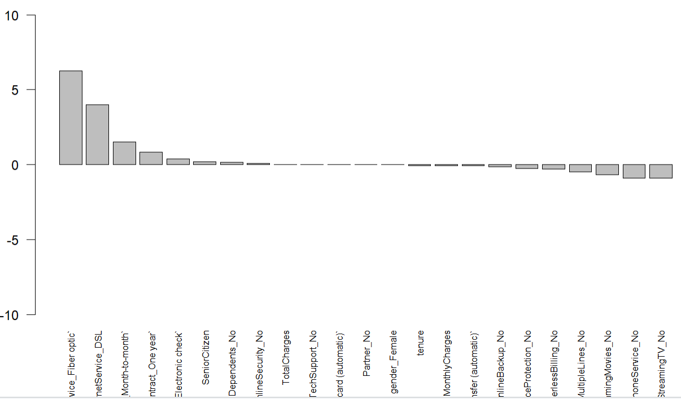

Slide 16
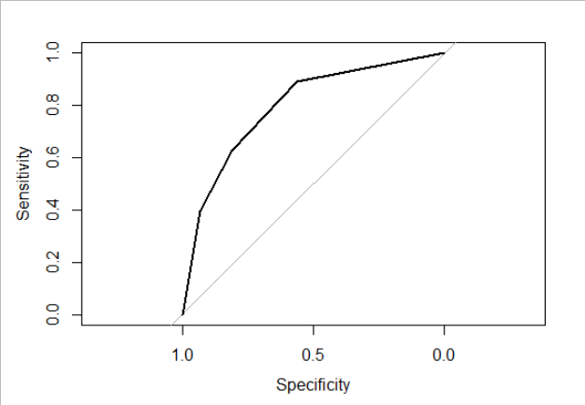
DECISION TREE
ROC CURVE
AUC : 0.7966

Slide 17
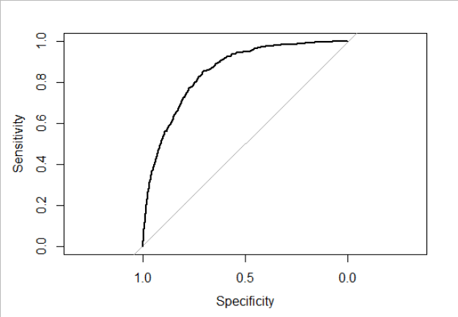
LOGISTIC REGRESSION ROC CURVE
AUC : 0.8508

Slide 18
Conclusion
Since the AUC of the Logistic Regression is higher than that of Decision tree, Logistic Regression is a better model for our analysis.
InternetService and Contract type are major factor affecting churn rate of the company
Business strategies should be focused on the improvement of internet service provided to customers so that churn rate can be minimized
Business should also focus on converting less tenure customers to high tenure to improve churn rate.

